Slide 1
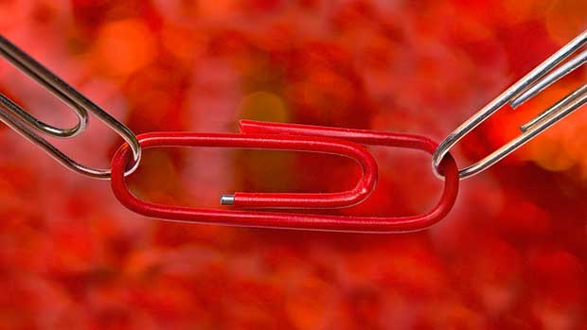
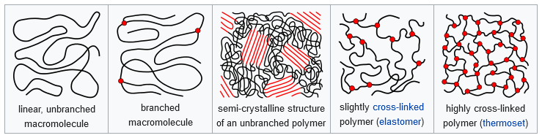
Polymers
Introduction and Addition polymers

Slide 2
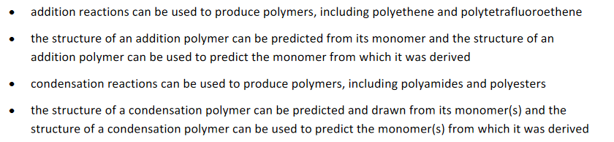
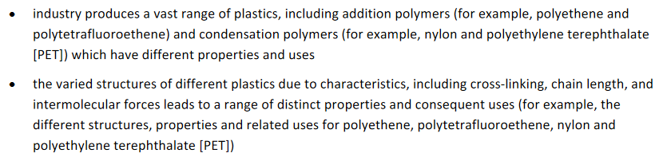
SCSA outline

Slide 3
Polymers - general
Polymers – “poly” meaning many, “mer” meaning parts. Many parts.
The terms polymer and plastics are often used interchangeably but plastics are just one type of polymer. Plastics can the moulded and expanded when heated.
Thermoplastics:
Polymers that soften and melt when heated. Easy to recycle.
Examples included PET, HDPE and PVC
Thermosetting:
Do not soften when heated, they cannot be reshaped
Natural polymers include polysaccharides (like cellulous, cotton), proteins (e.g. wool, silk), DNA and RNA

Slide 4
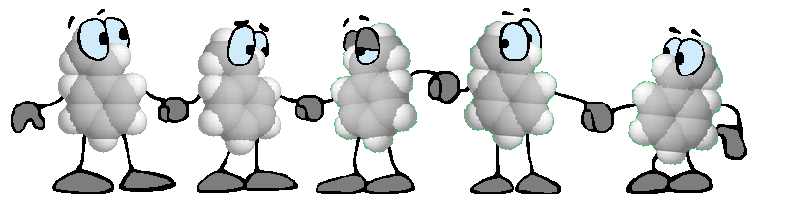
Polymers - Monomers
Many monomers are obtained from crude petroleum or coal
Bond together to form large molecules – polymers!
They have a structure which can change to accommodate the additional
bond to join them together (either double bond or functional group)
The process in which the monomers link together to form polymers is
known as POLYMERISATION

Slide 5
Types of polymers
There are two types in this course:
Addition polymerisation
Condensation polymerisation

Slide 6
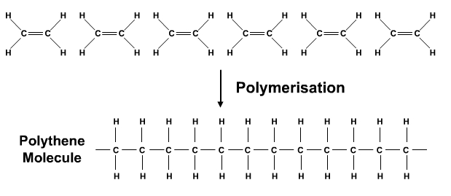
Addition polymers
Involves opening of a carbon-carbon double bond to join the monomers together
Requires an initiator to start the chain reaction
By opening up the double bond to a single bond allows the monomers to have extra bonding capacity
Most simple example is formation of polyethylene

Slide 7
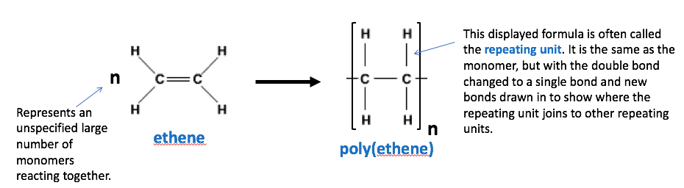
Addition polymers

Slide 8
Addition polymers – drawing
Redraw the alkene so that the groups point up and down instead of out on an angle
Draw a reaction arrow and redraw the monomer with a single bond and additional bonds on the left and right
Add round brackets so they intersect the additional single bonds
Add an “n” in front of the monomer and next to the bracket (bottom right)
Add “initiator” above the reaction arrow
H
R
H
R
H
R
initiator
C
C
n
C
C
C
C
H
H
H
H
H
H
n

Slide 9
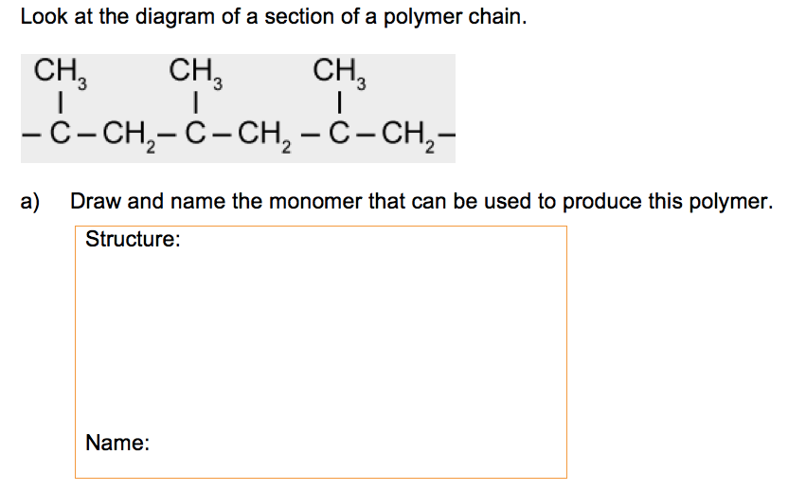
Addition polymers – practice

Slide 10
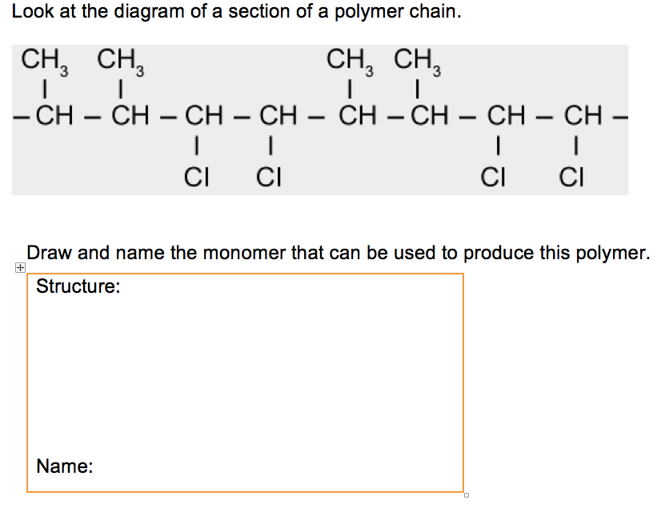
Addition polymers – practice

Slide 11
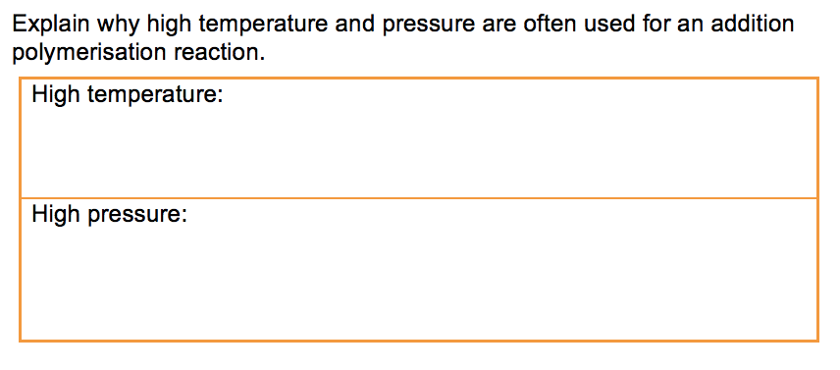
Addition polymers – practice

Slide 12
Structure and properties
Properties of a polymer are affected by:
Intermolecular interactions (depends on nature of the repeating unit)
The length of the polymer chains
Linear or branched structure
Cross-linking

Slide 13
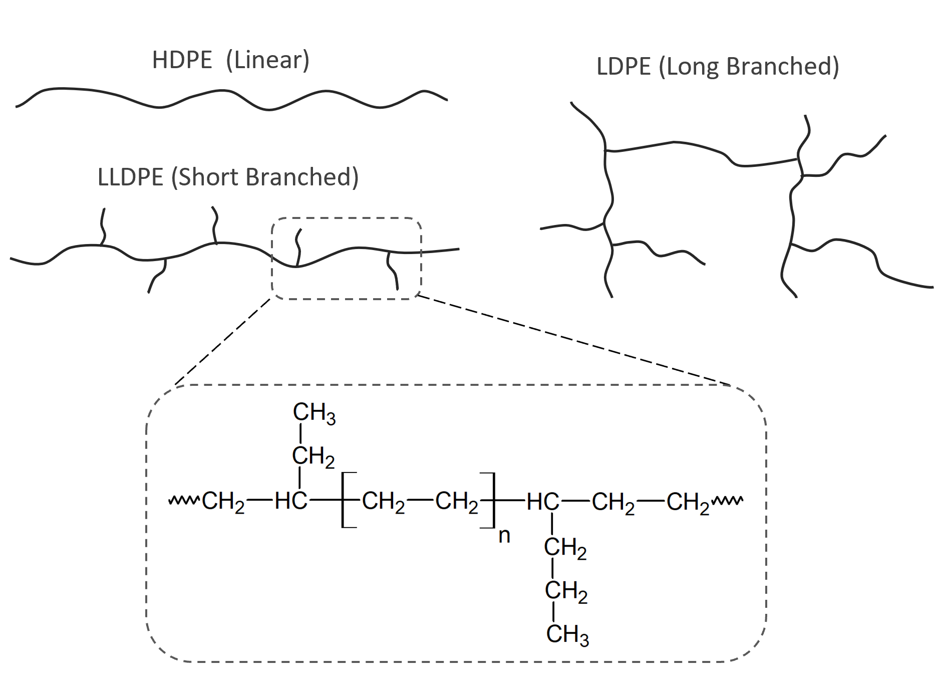
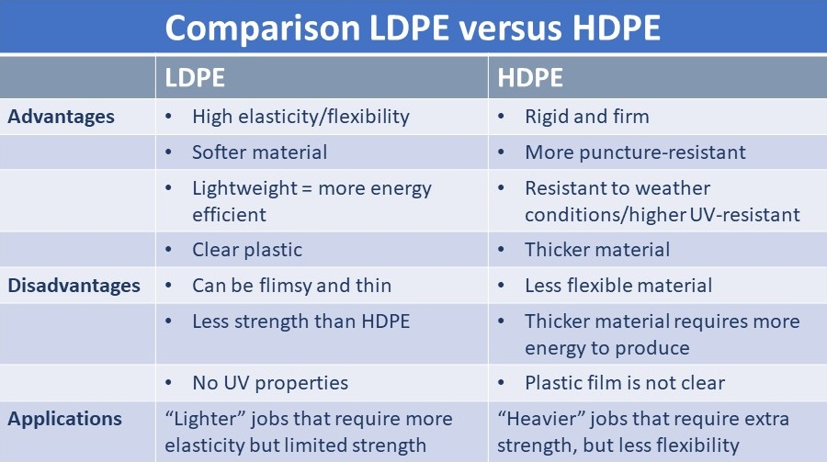
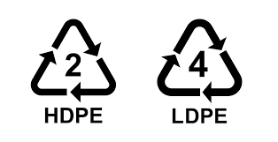
Polyethene (PE)

Slide 14
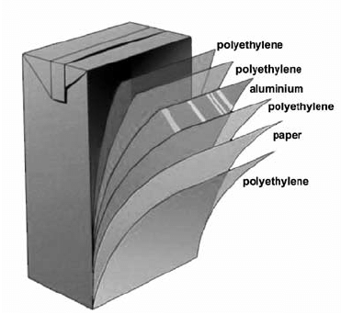
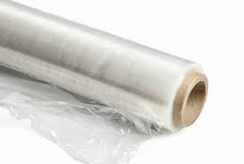
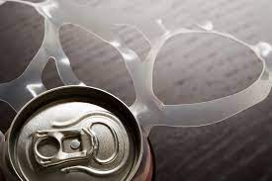
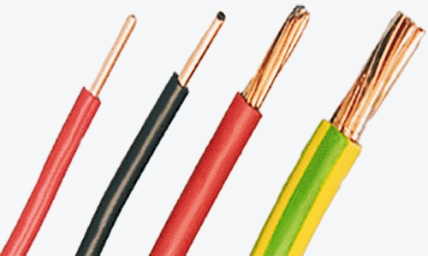
Polyethene (PE)
Low-density polyethene (LDPE)
Synthesis – high temp and pressure
Thermoplastic
Has more branching, so weaker IMF and amorphous (irregular structure)
Low melting point, low tensile strength, soft, flexible, break down more easily than other plastics

Slide 15
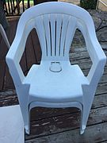
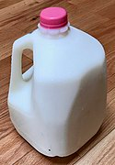
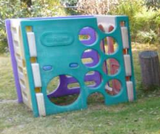
Polyethene (PE)
High-density polyethene (HDPE)
Synthesis – Ziegler-Natta catalyst allows for lower pressure and temperature
Long, straight polymer chains, stronger IMF and more ordered structure, more crystalline.
Stronger polymer, stiffer, higher density, higher melting point

Slide 16
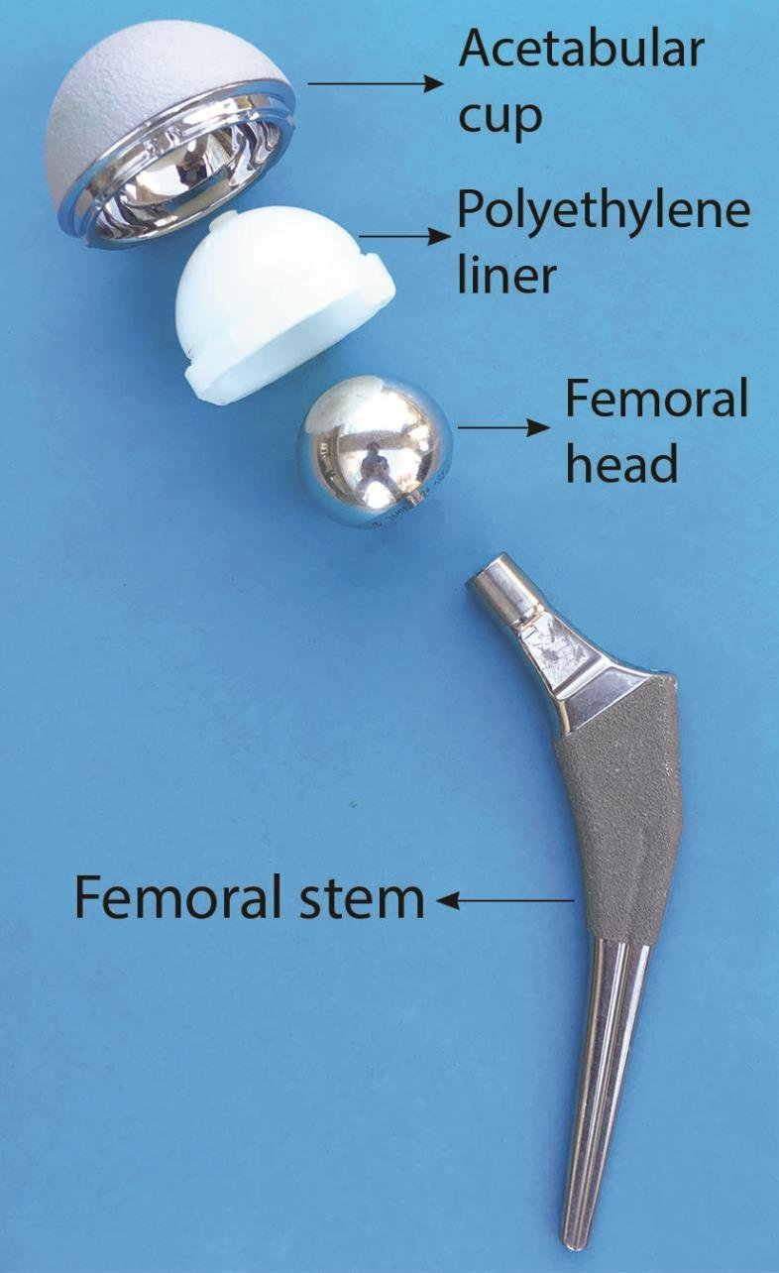
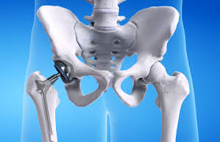
Polyethene (PE)
Ultra high molecular weight polyethene (UHMWPE)
Polymer chains of UHMWPE are around ten times longer then HDPE
The significant increase in dispersion interactions makes it very tough
Used for socket section in hip replacement!

Slide 17
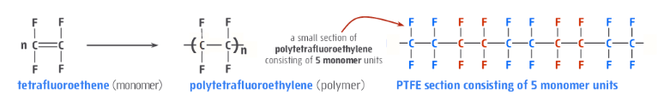
Polytetrafluoroethylene (PTFA or Teflon)
The presence of fluorine atoms gives some unique properties:
C-F bond is very strong compared to a C-H bond, contributes to PTFE being more chemically resistant then PE, and more stable.
C-F resists bonding to other things making it non-stick and makes the surface low-friction

Slide 18
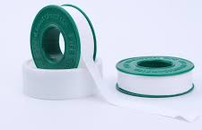
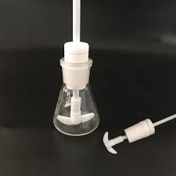
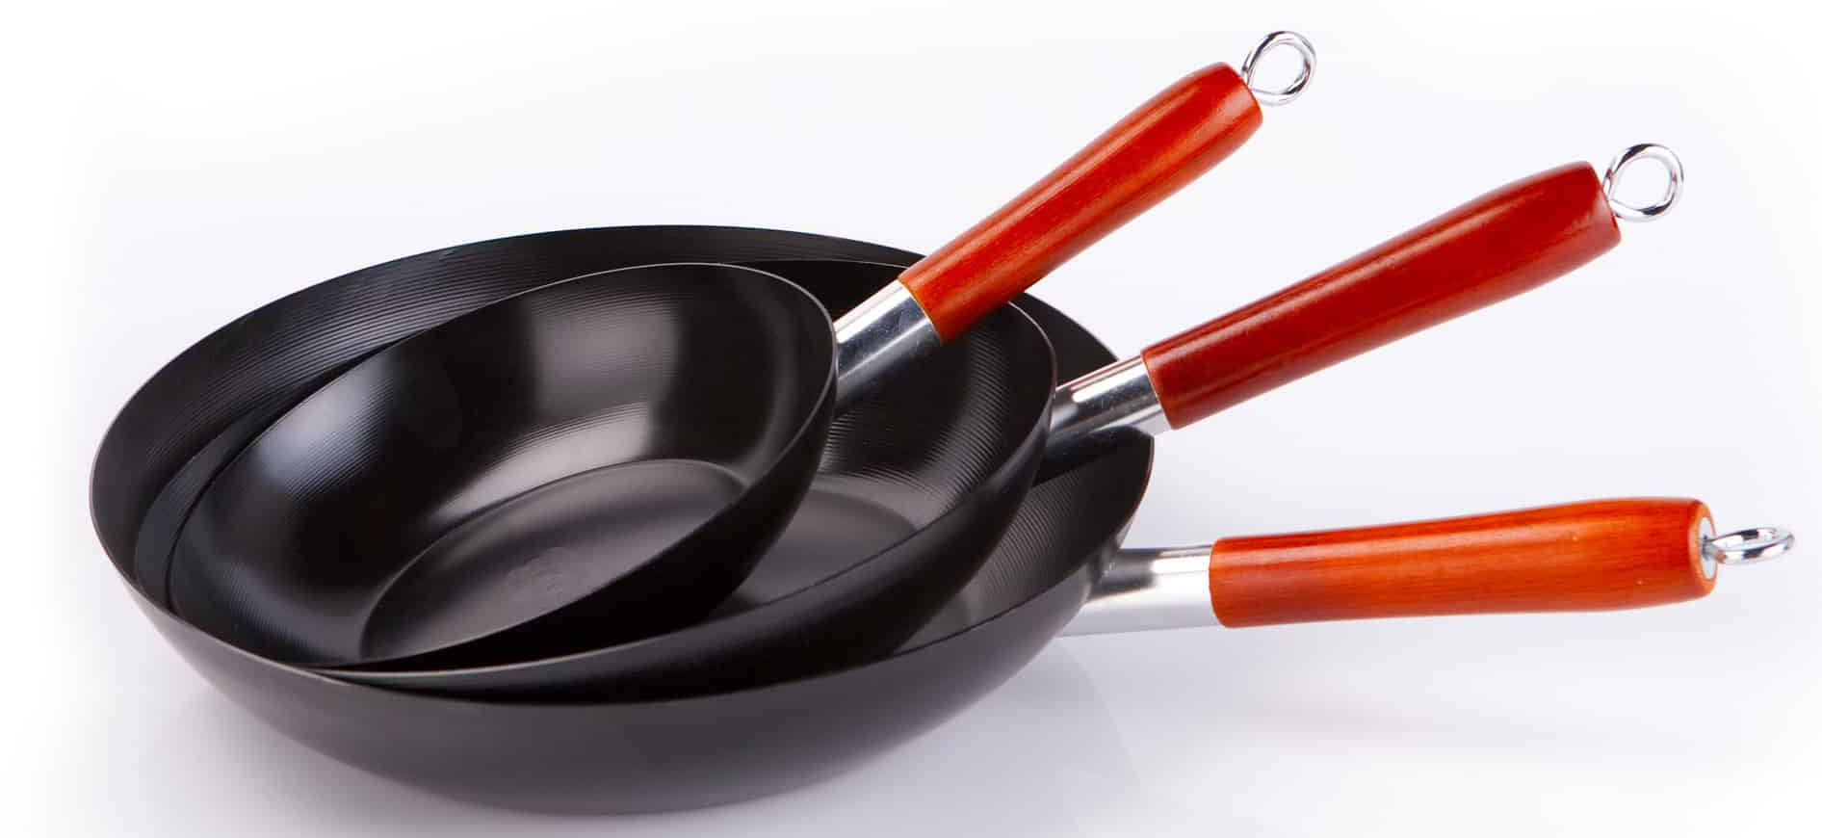
Polytetrafluoroethylene (PTFA or Teflon)
Used for – non-sticking cooking equipment, solid lubricants (Telfon tape), gears, large chemical reactors and associated equipment.

Slide 19
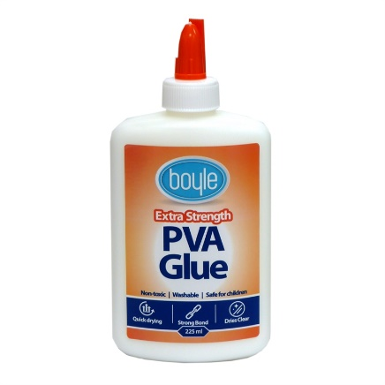
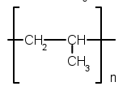
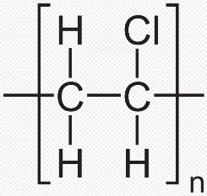
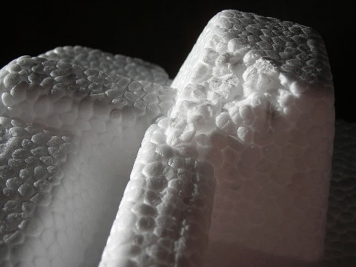
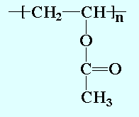
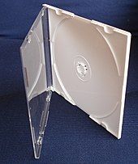
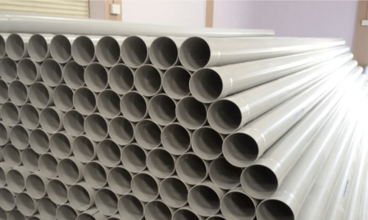
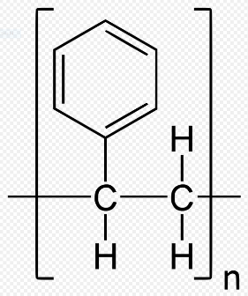
Extra examples
Polymer | Structure | Properties/uses
Polypropene (or polypropylene) |  | Low density, rope, carpet, toys, car parts
Poly(chloroethene) (Polyvinylchloride or PVC) |  | Hard but brittle, pipes
Polyvinylacetate (PVA) |  | Wood glue, cross links with borax. Thermoplastic
Polystyrene |  | Can be Low or high density. Eg expanded foam – packing material/thermal. Electrical goods

